Slide 1
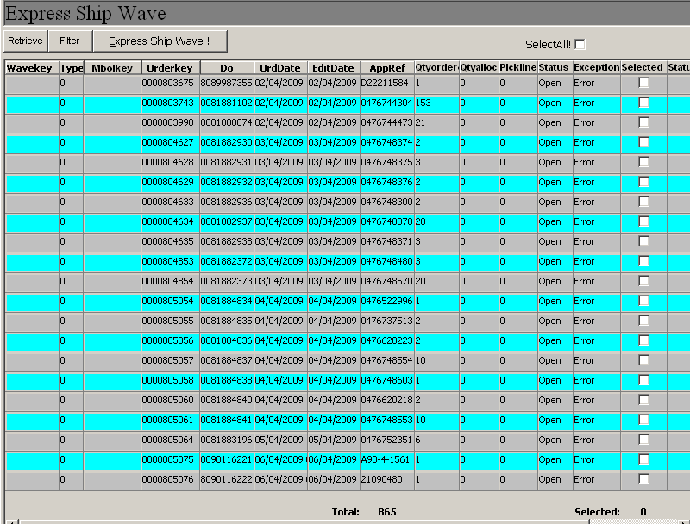
1) Express shipwave Screen
Remove “TYPE” column, Add in “HAWB#” , “KGB / KBB” (order header), fixed “select” at first column
Notes:
Remove “TYPE” column, Add in “HAWB#” , “KGB / KBB” (order header), fixed “select” at first column

Slide 2
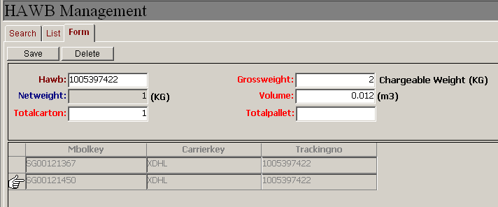
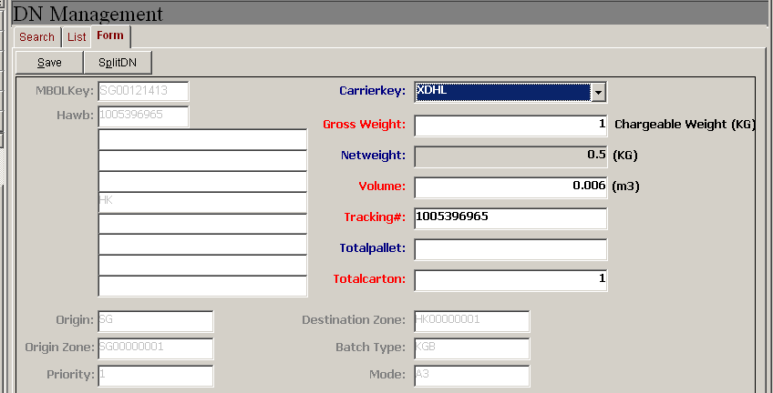
2. Remove DN Management screen
- Admin has been spending double data entry to update this screen, this screen is duplication of HAWB screen

Slide 3
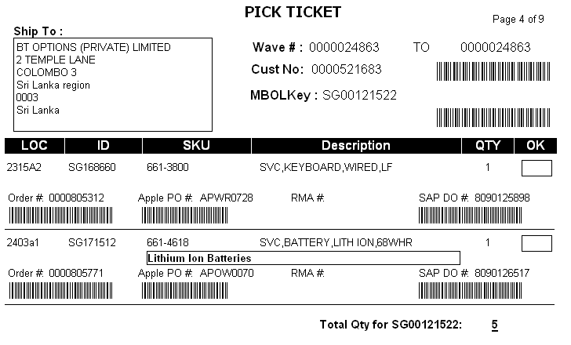
3. Pick ticket enhancement
Add new summary column for each MBOL key
Total (Amt in USD), next to total qty

